Slide 1
Trainee Selection System
Presented by:
Mohammad Naimur Rahman(ID:30063)

Slide 2
Contents:
Project Summary
df
Trainee Selection System
Feature List
Things that enhances the beauty of TSS
Technologies/Tools
Things that were used to build the TSS software
UI Representation
Visualizing the UI
Learnings From TSS
Things that is learned from this project
Major Challenges And Solutions
Problems that we faced

Slide 3

PROJECT SUMMARY

Slide 4
Project Summary
Trainee Management System is a project which will be used for hiring the user by written test/Technical Viva, HR Interviews.
Applicant can do registration and apply on circular and Admin can approve and give marks, update and other things

Slide 5
Feature List of TSS
Login/Registration
Apply for the desired circular
Approval of applicants
Admit Card Generation
Track Participants of the Exams
Upload Marks of the Participants

Slide 6
Feature List of TSS
Applicant Dashboard/Notice Board
Upload Marks and Prepare Results
Select Final Trainees List

Slide 7
Technologies/Tools
Developed spring boot application using Intellij Idea
Developed front end using React Js. Used VS Code IDE
Used redmine for project management
Used Git for version controll
Implemented Spring Security, Authentication and Authorization

Slide 8
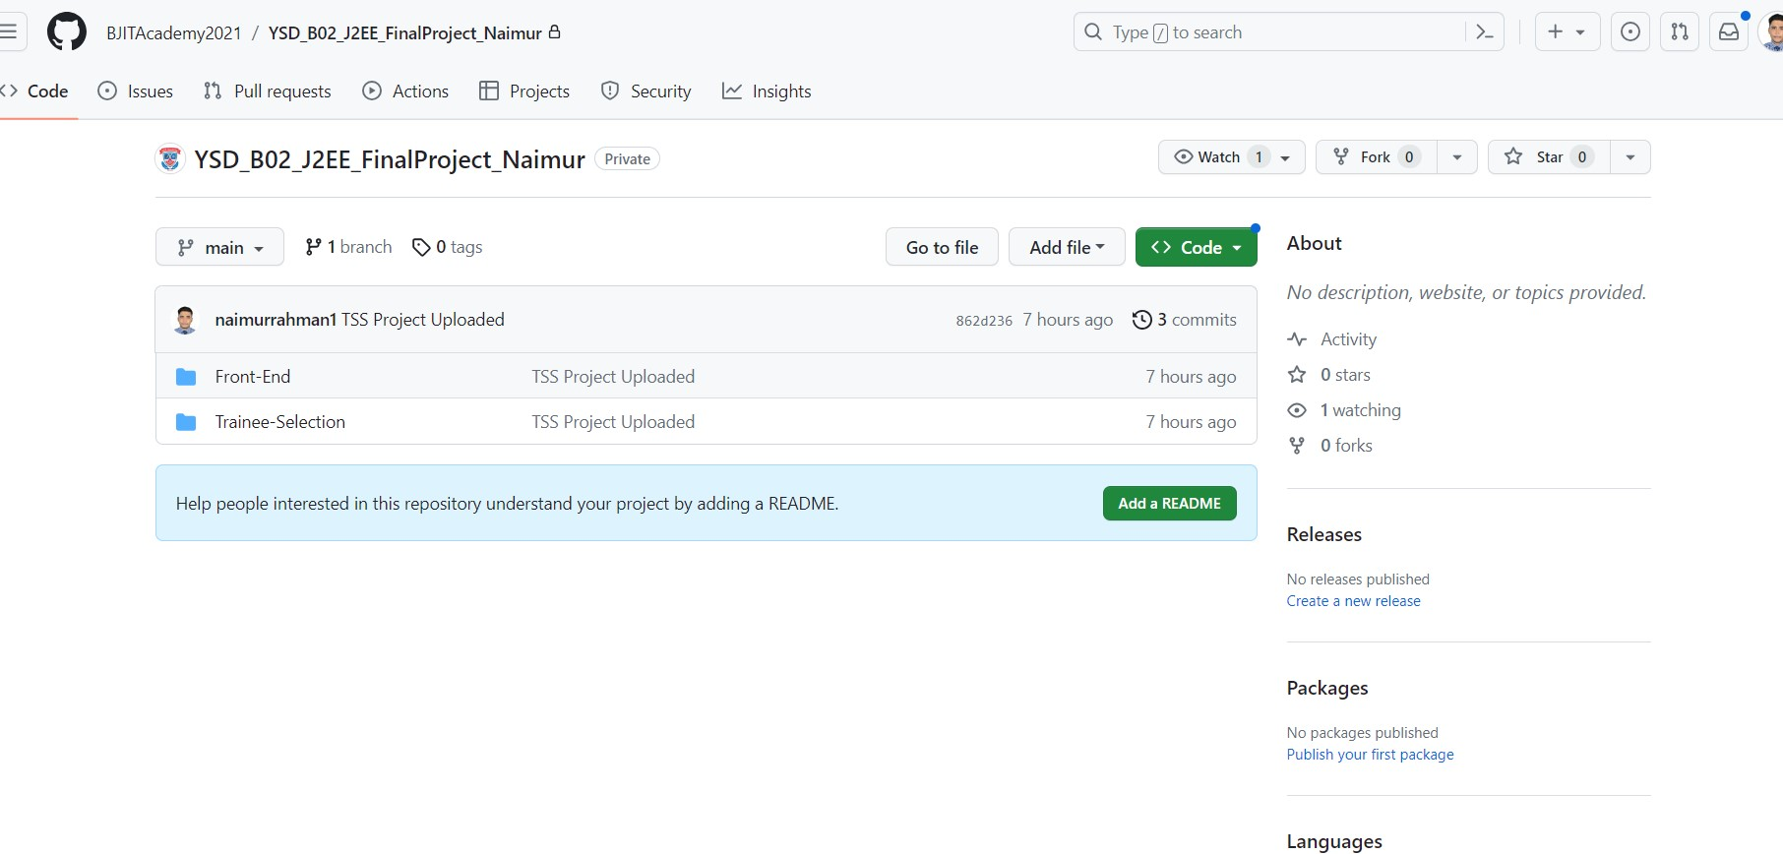
GitHub

Slide 9
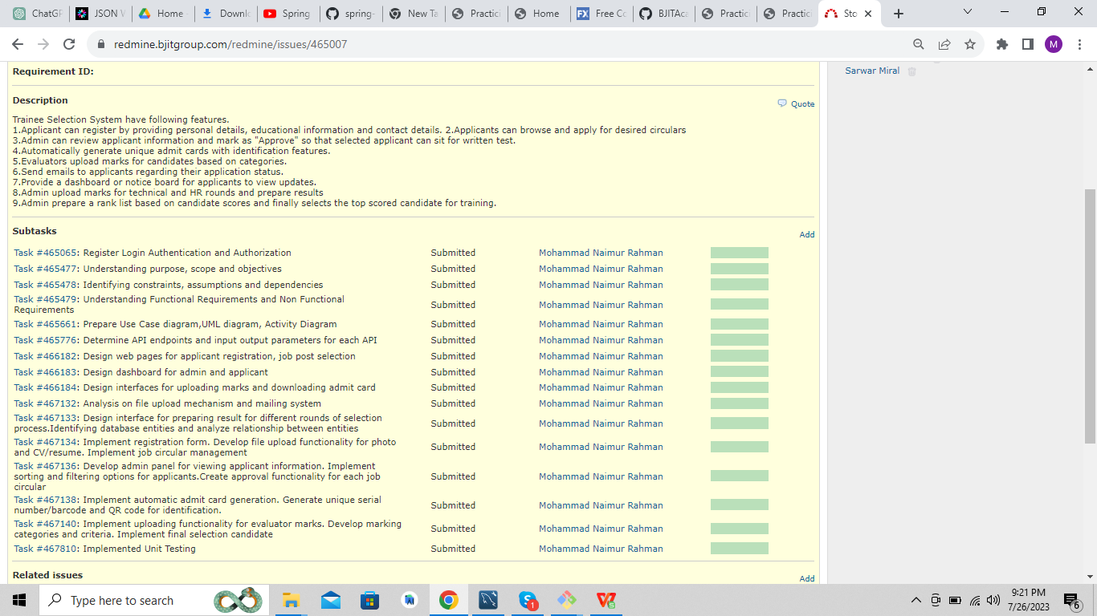
Project Management through Redmine

Slide 10
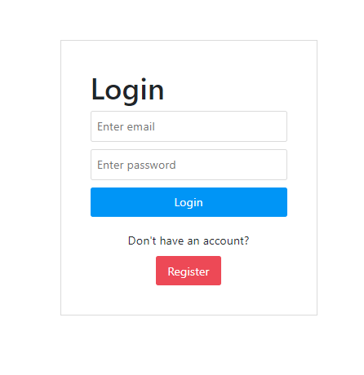
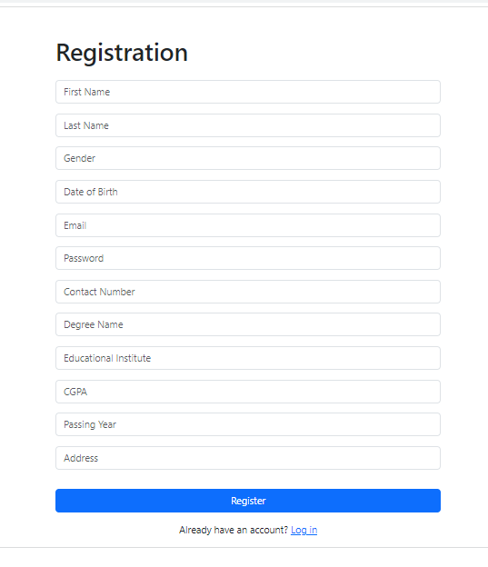
User Interface Representation
Registration and Login Page

Slide 11
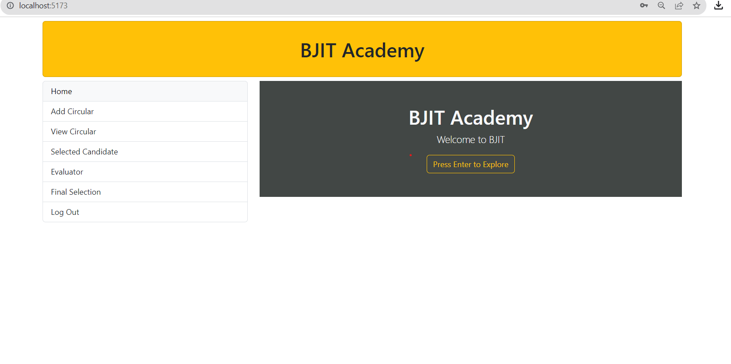
User Interface Representation
Home Page

Slide 12
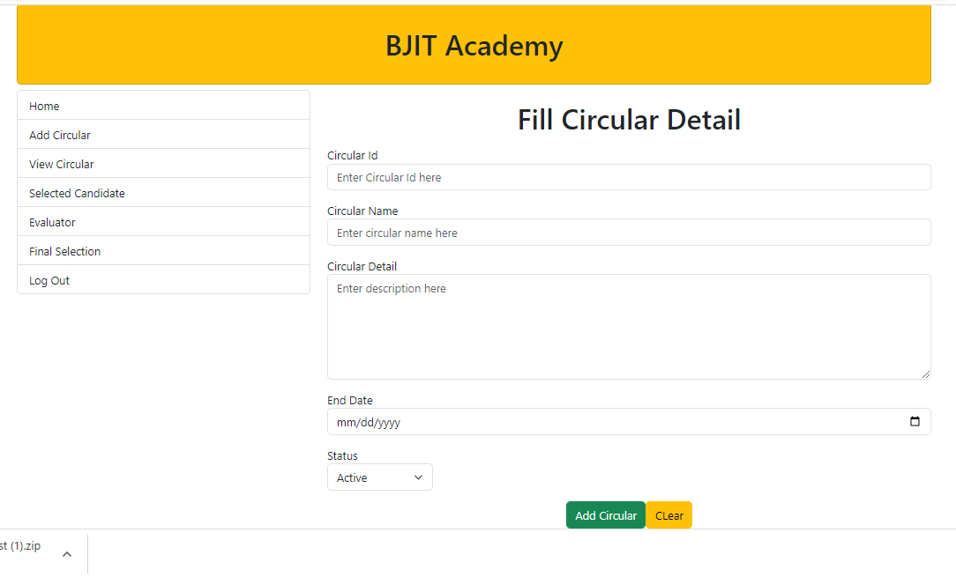
User Interface Representation
Add Circular Page

Slide 13
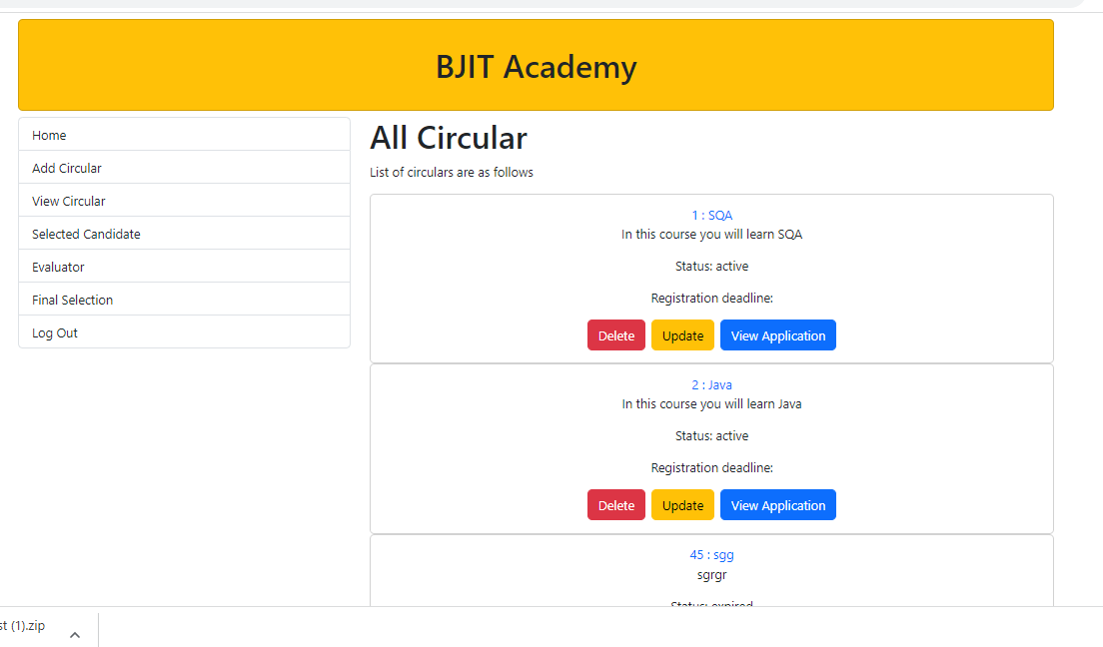
User Interface Representation
View Circular Page

Slide 14
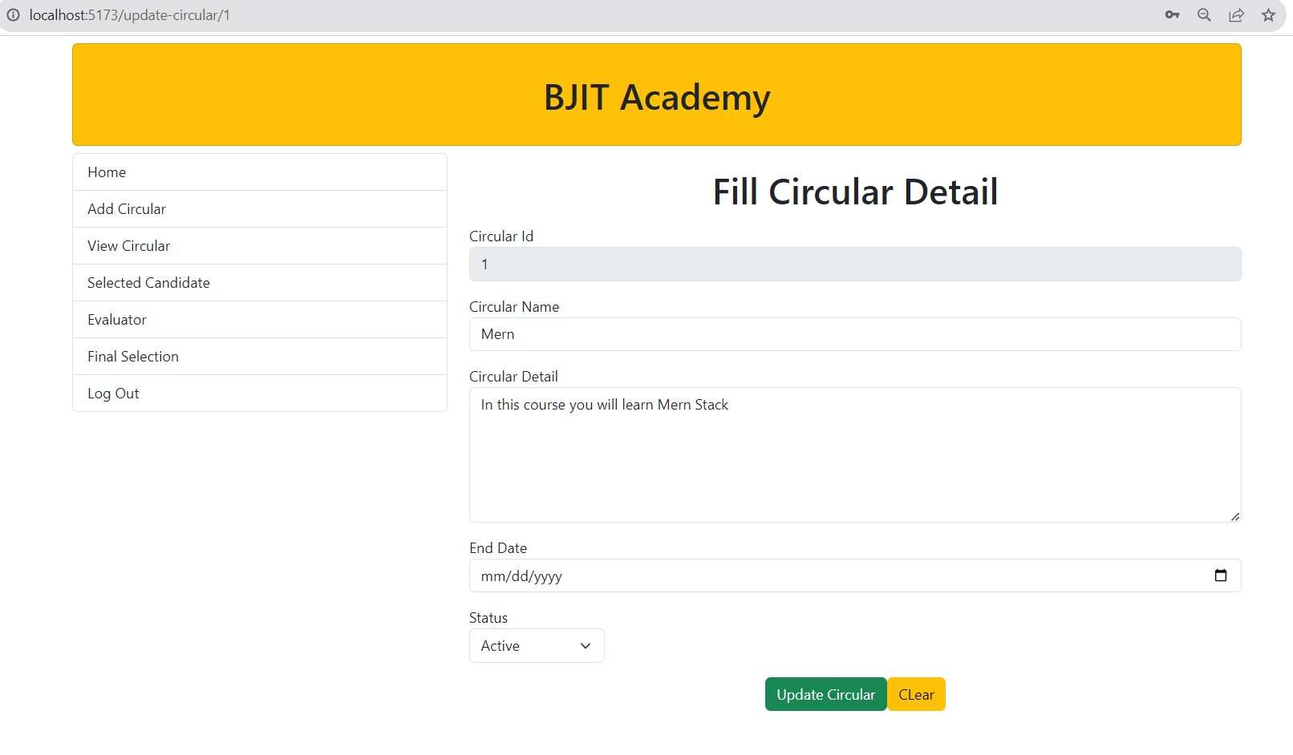
User Interface Representation
Update Circular Page

Slide 15
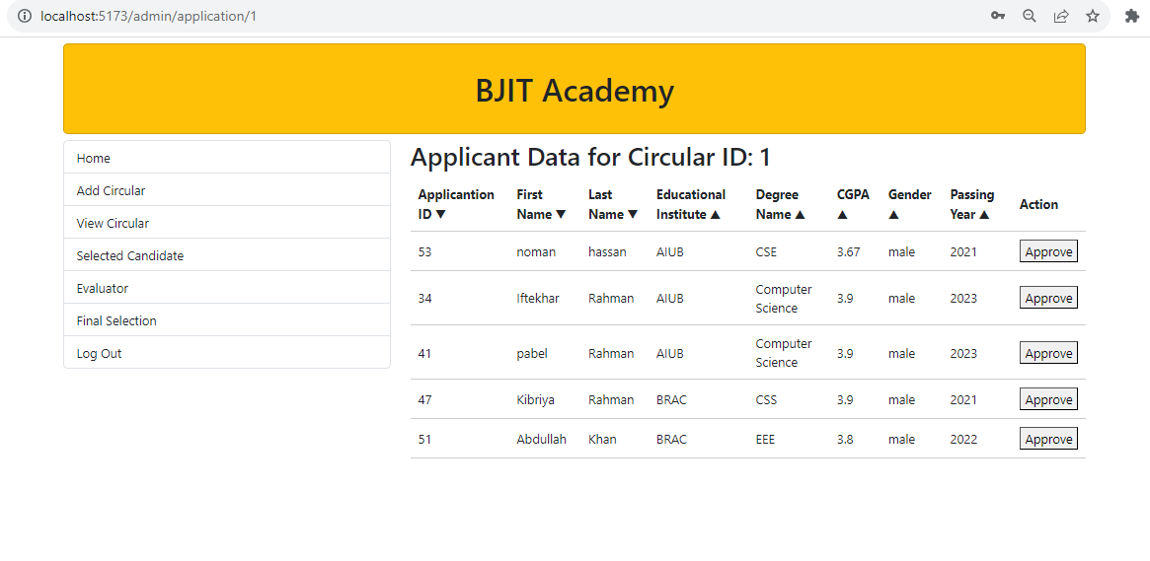
User Interface Representation
View Application Page

Slide 16
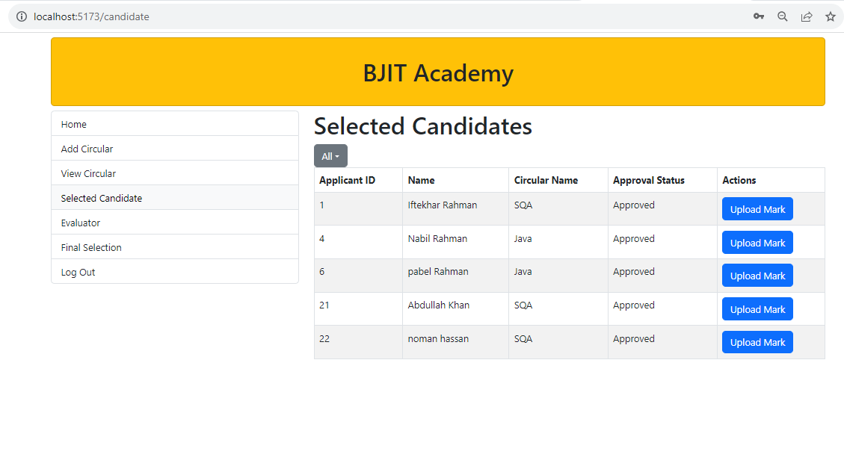
User Interface Representation
Selected Candidate Page

Slide 17
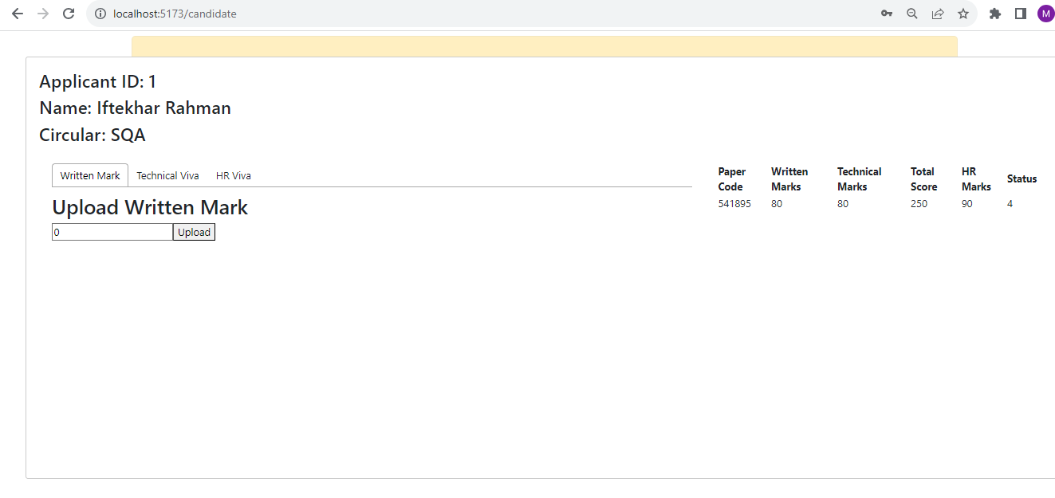
User Interface Representation
Upload Mark Page

Slide 18
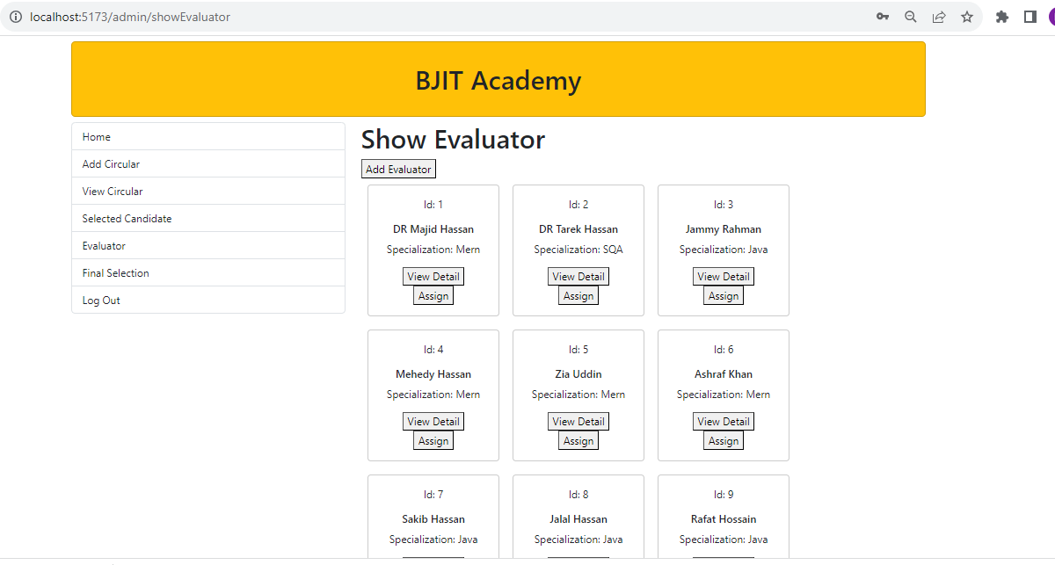
User Interface Representation
Show Evaluator Page

Slide 19
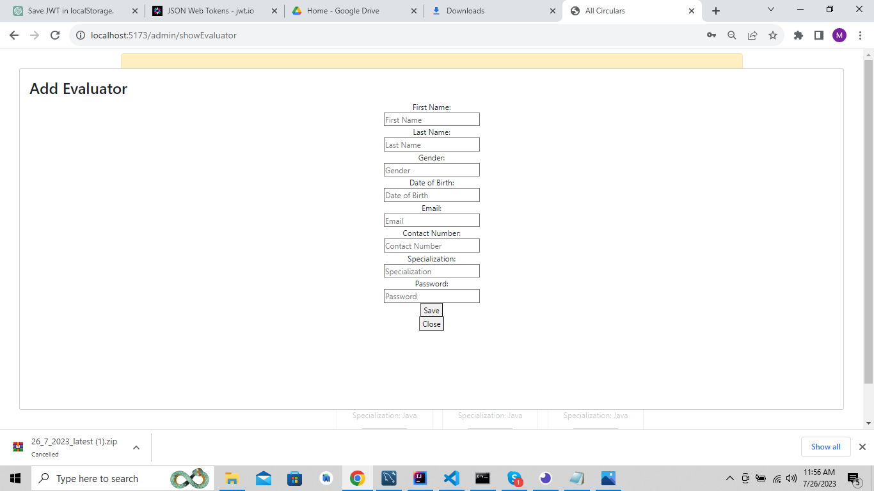
User Interface Representation
Add Evaluator Page

Slide 20
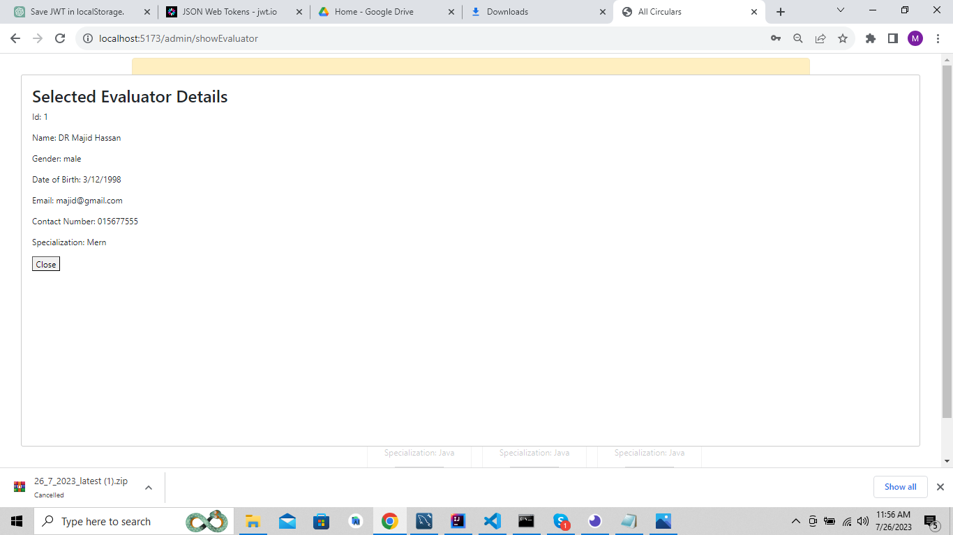
User Interface Representation
Show Evaluator Detail Page

Slide 21
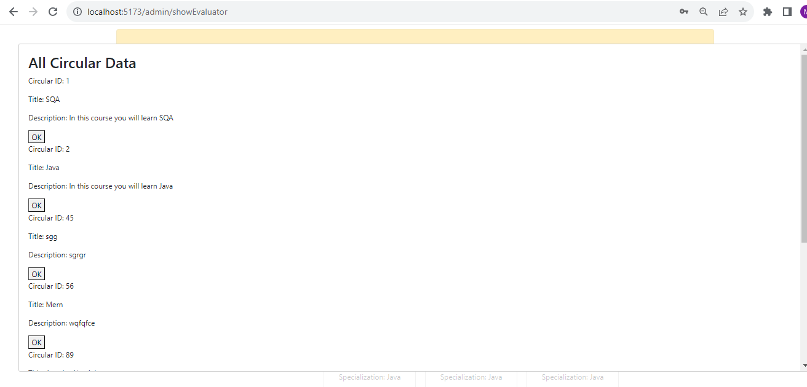
User Interface Representation
Assign Evaluator Page

Slide 22
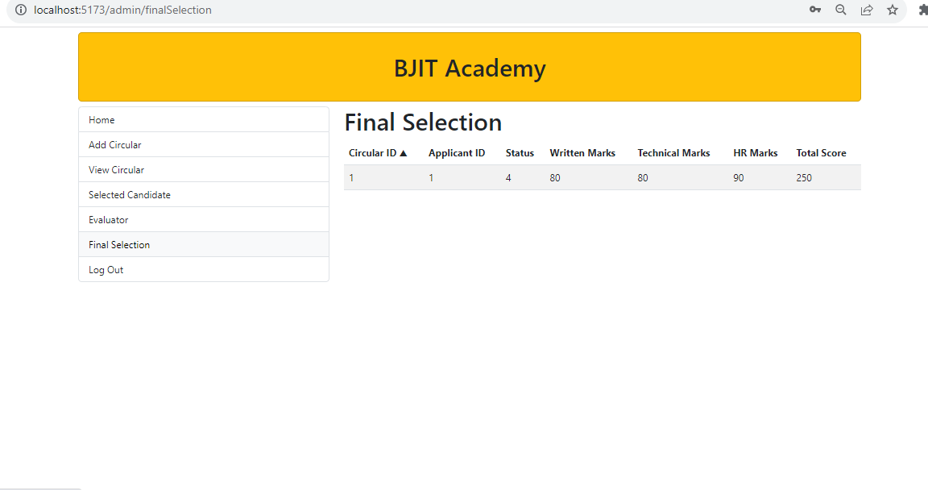
User Interface Representation
Final Selection Page

Slide 23
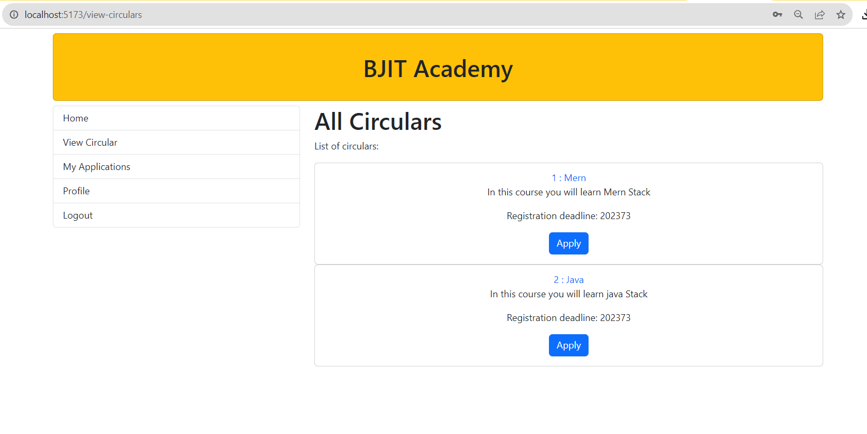
User Interface Representation
Applicant View Circular Page

Slide 24
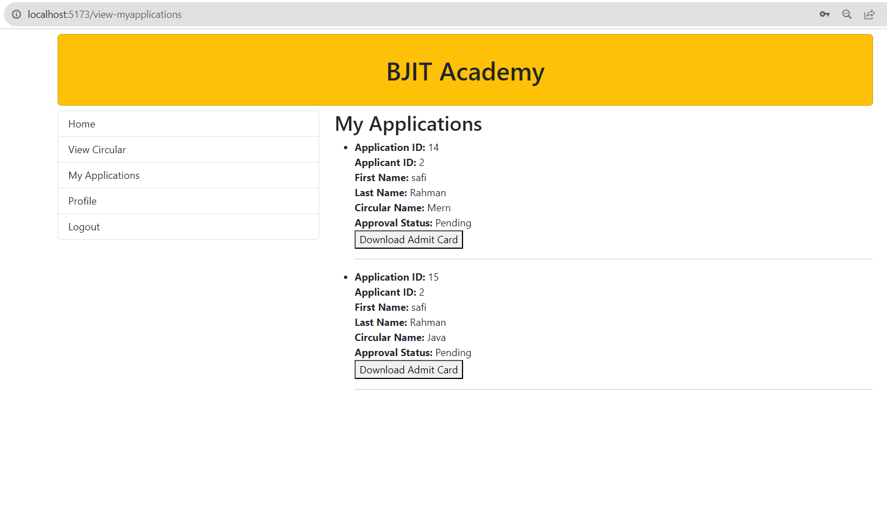
User Interface Representation
Applicant Applications Page Detail

Slide 25
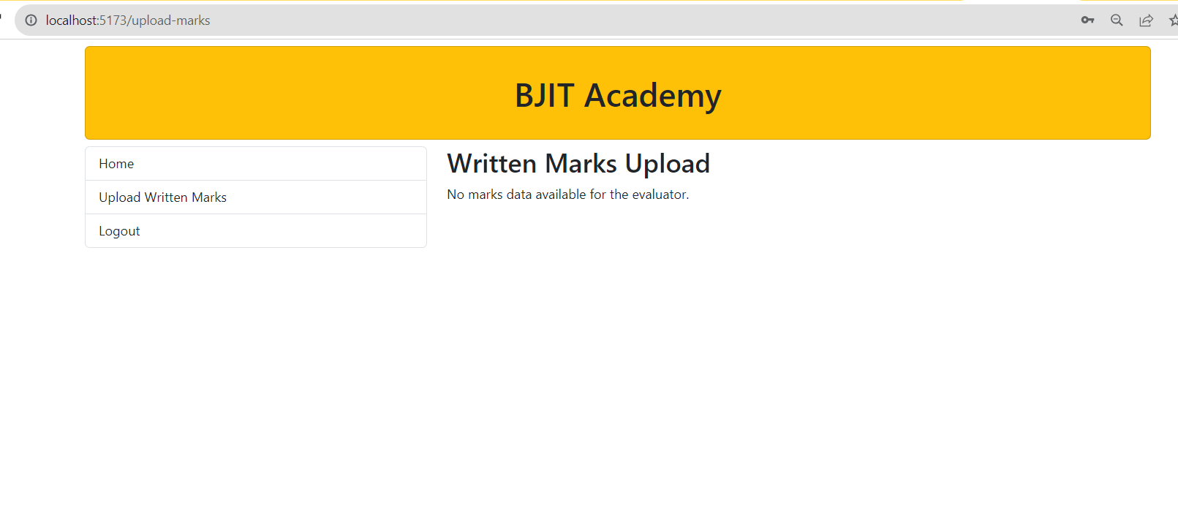
User Interface Representation
Evaluator Marks Upload Page

Slide 26
Learnings From TSS
Spring Boot
React Js
Implementing Security Authentication Authorization
Integrating Back End with Front End
Time Management(WBS)

Slide 27
Major Challenges And Solutions
Integrating front end with back end
Working with React Js

Slide 28
Thank you
Any questions?

